Slide 1
Geographical Discovery, Imperialism & Colonialism
Dr. Md. Faruk Shah
Adjunct Faculty Member
Department of History and Philosophy
North South University

Slide 2
Lecture Outline
Definitions of Imperialism and Colonialism
Factors behind the growth of colonial system
Types of Colonial system
The difference between the British colonial system and the others
The Impact of Colonialism

Slide 3
Colonialism
A system of social, economic, political and cultural relations characterized by:
the imposition of authority by an imperial power and nullification of the rights and political structures of the prior occupants of the territory
economic exploitation through the extraction of economic surplus and resources that are shipped to the home country of the imperial power
relations of asymmetrical power
a justifying ideology
administration of the territory and the peoples by a bureaucracy

Slide 4
Motives for colonialism
Nationalism, economic, or cultural
“God, gold, and glory”
  Missionaries spreading Christianity
  Resources for European economies
  More colonies = more powerful state

Slide 5
First wave: 1492 to 1825
Location, location, location
  European trading cities oriented to the sea
  West African trading cities oriented inland
  East Africa, China and India farther away from Americas
  Trade winds favored Europe

Slide 6
Portuguese colonialism
Earliest explorers in Africa
Policy of trade, not settlement
  Gold as part of mercantilism
  Diseases harmful to Europeans
Developed slavery system in late 1400s
  Laborers as commodities to be used up

Slide 7
French colonialism
Settlement/trade major motivations
  More equal interactions with Natives
  Fewer settlers
  Less penetration inland

Slide 8
English colonialism
Still different political situation
Focus on settlement
More hostile towards natives

Slide 9
First wave: Impacts at home
Portugal and Spain
  Colonies as resource-based economies
France
  Less settlement, less impact
Great Britain
  Learned from others, rose to greatest prominence

Slide 10
Second wave: 1885-1900
Europe needed new markets
Surplus population from demographic transition
Increased nationalism
Geographical expeditions to Africa promised resources, markets

Slide 11
Imperialism is…….
A policy of extending a country’s power and influence through colonization, use of military force, or other means’ (Oxford Dictionary, 1999)
The search for resources and new markets to increase profits fueled British colonialism.
The expansion of colonialism was justified on the ground that native peoples were not capable of governing themselves and hence needed the colonialist to provide and maintain order.
The post-colonies are divided into settler (Australia), non-settler (India), and mixed (South Africa)

Slide 12
Imperialism
Stronger nation seeks to dominate a weaker nation politically, economically, and socially
Broken down into 2 periods
  The Old Imperialism
  The New Imperialism

Slide 13
The Old Imperialism
1500-1800
Europeans establish colonies in Americas, India, Southeast Asia, Africa & China
European power was limited

Slide 14
The New Imperialism
1870-1914
Japan, U.S. & industrialized nations of Europe became more aggressive in expanding into other lands
Focused mainly in Asia & Africa
  Declining empires & wars left them vulnerable

Slide 15


Causes of the New Imperialism
Economic
Need for natural resources & new Markets (Industrial Revolution)
Place for growing populations to settle
Place to invest profits

Slide 16

Political
Bases for trade & military ships
Power & security of global empire
Spirit of nationalism

Slide 17

Social
Missionaries Spread Christianity
Share western civilization
Belief than western ways are best
  Racism
Social Darwinism

Slide 18
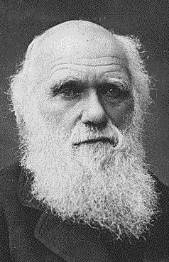

Social Darwinism
Applied Darwin’s theory of Survival of the fittest to competition between nations
Natural for stronger nations to dominate weaker ones

Slide 19
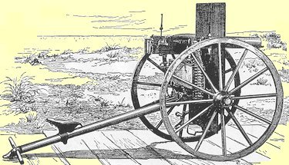

Western Advantages
Strong economies/governments
Powerful Armies & navies
Superior technology
  Maxim Gun
  Steam driven warships/railroads
  Medical advances
VS.

Slide 20
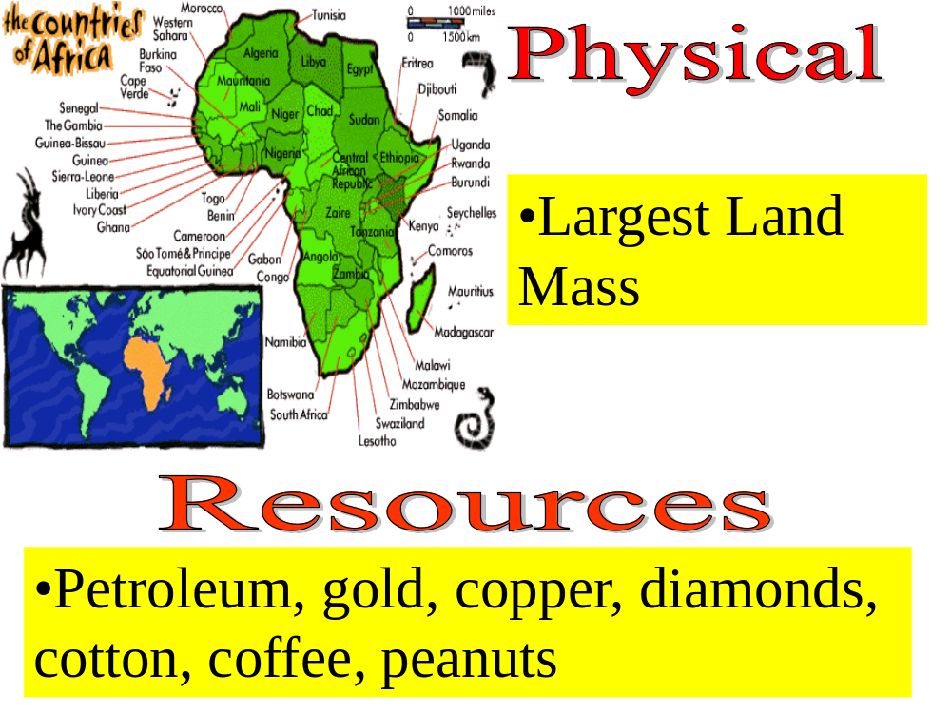

Slide 21
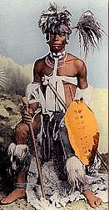
Africa Before Imperialism
Divided into 100’s of ethnic & linguistic groups
Mixture of large empires & small independent villages
Most practiced traditional beliefs
  Others practiced Islam & Christianity

Slide 22

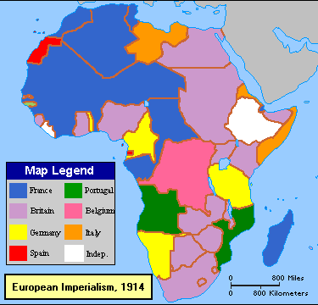
British Imperialism in Africa
Scattered throughout Africa
Controlled heavily populated regions heavy in resources
Parts of West & East Africa, Egypt, & most of Southern Africa

Slide 23
Positive Impacts of Colonial Rule
Reduced local warfare
Improved sanitation, hospitals & education
African products popular in European Market
Improved infrastructure
  Railroads, dams, telephones & telegraph lines

Slide 24
Negative impacts of Colonial Rule
Lost land & independence
Death caused by new disease & resistance
Change to cash crops resulted in famine
Breakdown of traditional culture
European establishment of boundaries (Problem today)

